Slide 1
Oil and Gas in Africa: A Prospective Study
AfDB/AU Study
Presentation by the AfDB’s Chief Economist’s Complex to the AfDB/WB Experience-sharing Meeting on EI
12 February 2007

Slide 2
Outline of Presentation
Key Questions Addressed in the Study
Main Trends and Patterns in African Oil and Gas
Oil and Gas Prospects
Key Policy Issues and Challenges

Slide 3
1 Key Questions Addressed in the Study
  How can Africa achieve expanded energy access and oil and gas wealth sustainability, efficiently and effectively within a generation?
  What do we know and what have we learnt about Africa’s oil and gas contextualized in global perspectives?
  What are the requirements for managing efficiently the adjustment challenges of coping with the costs of the external shocks associated with oil and gas market changes?

Slide 4
2. Main Trends and Patterns in African Oil and Gas
Africa is well endowed with energy resources including oil and gas. 9.5% of global crude oil reserves and 8% of gas reserves are in Africa.
In 2005, 12% of global production came from Africa, but the region only consumes 3.4% of global oil. Africa’s share of global gas consumption is only 2%.
Oil and gas resources are concentrated in a relatively small number of countries and sub-regions (North and Western Africa).
These are Nigeria, Algeria, Libya, Angola, Egypt, Sudan, Equatorial Guinea, Congo Republic, Chad, Gabon, Tunisia and Cameroon.
There are noticeable changes in the geography of oil and gas supply in Africa in the last fifteen years. Notable among the new producing countries are Sudan, Equatorial Guinea and Chad.

Slide 5
2. Main Trends and Patterns in African Oil and Gas (contd.)
The global demand for African oil has steadily increased in recent years, strengthened by, among other factors, the geopolitics of oil and Asian Drivers, especially China’s strong demand.
The world oil and gas market prices have remained high and volatile. Spot market price for dated Brent almost reached $80 in July 2006 (see Figure 1).
There have been significant structural changes in the world oil and gas markets, exacerbating market volatility.
Global investment in oil and gas has been experiencing a significant downturn in the last decade.

Slide 6
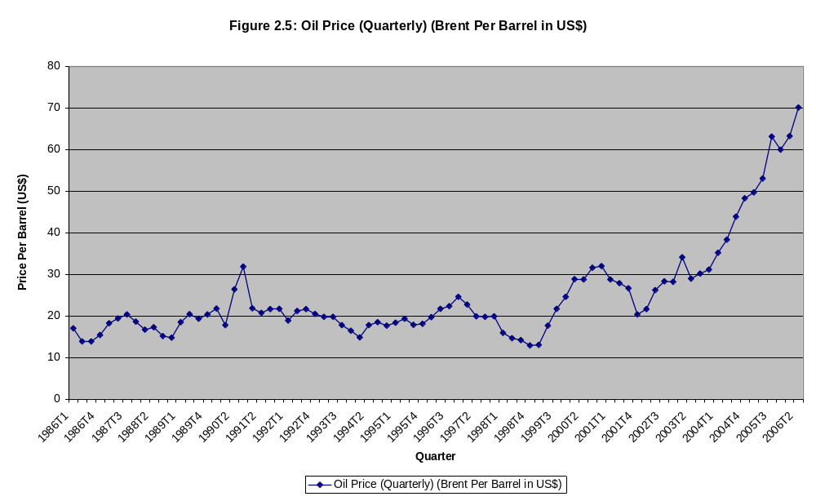
Figure 1: Crude Oil Price Trend (dated Brent) in US $ per barrel, 1986 to 2006.

Slide 7
2. Main Trends and Patterns in African Oil and Gas (contd.)
Oil exporting countries have experienced high oil and gas revenue volatility driven by global market developments.
Higher oil and gas prices have adversely affected net oil importing countries especially the land-locked and resource poor countries more than other countries.
There is substantial evidence suggesting more difficult economic conditions facing oil importing land-locked and coastal non-resource intensive countries in Africa.
Their recent per capita income and external sector performance indicators reveal dimensions of their problems.
There are contrasting demand and supply paths in the region reflecting diverse initial economic and social conditions and the oil-non-oil producing status of the country.

Slide 8
2. Main Trends and Patterns in African Oil and Gas (contd.)
On the aggregate regional supply-demand balances are positive.
However, there are significant demand-supply gaps at both sub-regional and country levels.
Although there are many refineries in the region, yet there is a sizeable and expensive dependence on oil imports from outside the Africa region.
Poor regional and intra-regional energy infrastructure linkages exacerbates the cost of domestic supplies especially in land-locked countries.
Oil products refined in the region are mainly produced in small, inefficient, poorly maintained and outdated refineries. The product quality of many refineries does not meet international standards.

Slide 9
2. Main Trends and Patterns in African Oil and Gas (contd.)
Oil and gas are central to the economic growth and fiscal situations of an increasing number of countries.
However, for many of them, the resource curse syndrome, oil price volatility, oil-related social conflict and poor oil revenue management have largely eroded the significant gains from higher export revenues.
African countries exhibit relatively low energy access level.

Slide 10
3. Oil and Gas: Prospects
A key question is:
Given Africa’s oil and gas resource endowment, can the region meet its short and medium-term oil and gas needs?
The answer is yes from the perspective of regional demand and supply balance.
Africa consumes less than 30% of its oil and gas output. It exports the rest.
By 2025, projections show proved reserves to increase to 296 billion under the high scenario, 292 billion barrels in the reference scenario and 290 billion barrels under the low scenario.
The reference case assumes a moderate annual growth of 3%. The optimistic scenario assumes an annual growth of 5% which is the annual production growth between 1995 and 2005. The low scenario assumes 2.5% production growth rate.

Slide 11
3. Oil and Gas: Prospects (contd.)
Supply projections show production reaching almost 20 million barrels a day in 2025 in the reference case This is more than double the production rate of 9.8 million barrels per day in 2005.
In the optimistic scenario, production increases about two-and-a-half times the level in 2005 to reach 26 million barrels per day. In the low scenario, production increases to about 18 million barrels per day in 2005.
Oil consumption is projected to more than double from 2.763 million barrels per day in 2005 to between 6.2 and 6.4 million barrels per day in 2025.

Slide 12
3. Oil and Gas: Prospects (contd.)
Even if we scale up oil consumption by 50% in light of expanded energy access objective, the regional supply-demand balance in 2025 remains strong.
At the overall regional level, the energy demand-supply balance situation provides room for optimism that substantially higher oil and gas consumption can be met with regional supplies with ample surplus for export.
Yet, despite this optimistic regional outlook, the country and sub-regional realities reveal multidimensional issues and challenges to expanded access by the bulk of the population to oil and gas in Africa.

Slide 13
4. Key Policy Issues and Challenges
Two factors have made Africa’s drive to achieve affordable and expanded access to commercial energy in the region more difficult.
  the structural changes in the world oil and gas markets which have made oil prices more volatile
  and more importantly, the price increases since 1999.
Mitigating the short term impact of higher energy prices.
Finding the large investment needed for the expansion in hydrocarbon productive capacity.
Financing the estimated $56-$80 billion of investment and maintenance expenditures to meet more than 100Gw of additional electric power capacity that will largely be fuelled by oil and gas.

Slide 14
4. Key Policy Issues and Challenges (contd.)
Regional security considerations amidst global concerns about oil and gas supply driven by geopolitical factors and other tensions in some key oil and gas exporting countries in the Middle East, Africa and Latin America.
Disparity in Domestic and Regional Oil Market Prices
The Broader Economic and Political Challenge: Minimizing/elimination of the adverse economic effects of the “spaghetti structure” of overlapping regional economic institutions and arrangements.
Transforming oil and gas resource wealth into sustainable development.
Governance, accountability and transparency in the oil and gas industry.
The information challenge: “planning without much fact” still prevails in Africa’s energy scene at all levels.

Slide 15
Thank you for your attention.

